Slide 1

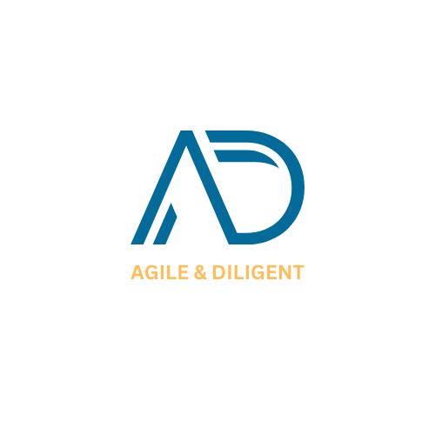

RETAINER LEGAL ADVISORY SERVICES
Long-term Legal Companion – Proactive Risk Prevention – Supporting Sustainable Business Growth
Legal counsel accompanying businesses in every commercial decision

Slide 2





Do Businesses Truly Need Regular Legal Counsel?
Ongoing legal issues arise, but maintaining a costly in-house legal department is not cost-effective.
Core Message
Effective legal management is not just about resolving disputes after they occur, but more importantly, identifying & controlling risks before they become a burden to the enterprise.
Commercial decisions and contracts are signed before comprehensive risks can be properly evaluated.
Complications in labor, corporate governance, tax, licensing & compliance arise on a daily basis.
Seeking legal counsel only after disputes arise leads to exorbitant costs and complicated resolution procedures.

Slide 3







What is Retainer Legal Advisory?
A service model where businesses engage AD Legal on a retainer basis, gaining continuous access to a professional legal team acting as their external In-House Legal Department.
01. Proactive
02. Continuous
03. Cost Control
Receive thorough advice and risk assessment prior to executing business decisions or entering major transactions.
Lawyers gain a deep understanding of your business model, operations, and legal history to deliver seamless support.
Proactively plan a fixed monthly/quarterly legal budget, eliminating unpredictable ad-hoc expenses.

Slide 4






Key Scope of Support (Part 1)
01. Corporate Governance & Internal Affairs
02. Contracts & Commercial Transactions
■
Advising on rights and obligations of members / shareholders
■
Drafting & reviewing various commercial contracts
■
Advising on operations of Members' Council, Board of Directors & General Meeting of Shareholders
■
Advising on negotiations & evaluating parties' rights/obligations
■
Reviewing internal resolutions, decisions, and meeting minutes
■
Drafting penalty for breach and damage compensation clauses
■
Advising on enterprise registration amendments, corporate restructuring & authority delegation
■
Advising on contract termination and rescission in compliance with the law
03. Labor & Human Resource Management
04. Operational Regulatory Compliance
■
Drafting employment contracts, internal labor regulations & internal policies
■
Reviewing compliance status & updating newly enacted regulations
■
Advising on labor discipline procedures and dismissal/termination
■
Advising on sub-licenses & conditional business requirements
■
Advising on labor dispute settlement with employees
■
Advising on personal data protection & consumer rights
■
Work permit procedures for foreign employees
■
Advising on regulations regarding advertising & sales promotions

Slide 5





Key Scope of Support (Part 2)
05. Investment & M&A
06. Risk Management
07. Incident & Dispute Handling
■
Advising on foreign direct investment into Vietnam
■
Identifying & evaluating operational and commercial risks
■
Assessing incidents & establishing legal standing
■
Capital contribution & transfer of shares / capital contributions
■
Proposing dispute prevention strategies
■
Developing optimal resolution scenarios for the enterprise
■
Drafting warning notices, demand letters, and formal responses
■
Drafting official legal documents & correspondence
■
Legal Due Diligence
■
Supporting negotiation & communication with business partners
■
Assisting throughout the execution of selected solutions
■
Drafting & reviewing M&A transaction documents

Slide 6










When Do Businesses Need AD Legal?
Before signing contracts
Before business decisions
“Are there any unfavorable terms?” → AD Legal reviews and flags critical risks.
“Is this plan compliant with the law?” → AD Legal assesses legal grounds & optimal directions.
When HR/labor issues arise
When partners breach commitments
“How should we handle this case?” → AD Legal advises proper procedures & completes standard dossiers.
“Do we have the right to penalize/terminate?” → AD Legal formulates strategies to protect your legitimate rights.
When regulations change
When preparing major deals
“How do new regulations affect us?” → AD Legal provides updates & timely adaptation guidance.
“What risks must be mitigated?” → AD Legal assists with due diligence & negotiations.

Slide 7



Professional 5-Step Working Workflow
RECEIPT
EVALUATE
ADVISE
EXECUTE
ACCOMPANY
Record information & legal requests from the business.
Examine dossiers, analyze relevant regulations & risks.
Propose feasible, secure, and compliant solutions.
Draft legal documents, assist with negotiations & procedures.
Monitor outcomes & provide ongoing, long-term support.
A dedicated legal contact – Deep business understanding – Prompt & continuous support.

Slide 8






Target Client Profiles
FDI & Foreign-Invested Enterprises
Small & Medium Enterprises (SMEs)
Requires an external legal team in Vietnam with deep local insight to support comprehensive operations & compliance.
Cost-optimized; no need for a full-time in-house legal team yet requires regular in-depth expert counsel.
Fast-Growing Enterprises
Corporations & Active Commercial Enterprises
Rapidly experiencing high volumes of contracts, hiring, business licenses & commercial transactions.
Frequently entering into contracts with customers, suppliers, and partners.

Slide 9
Flexible Service Packages
CRITERIA | BASIC PACKAGE | STANDARD PACKAGE | ADVANCED PACKAGE
Time Cap | 08 hours / month | 12 hours / month | 16 hours / month
Target Fit | Businesses with occasional legal advisory needs. | Businesses with active regular commercial operations. | FDI enterprises and corporations with high legal demands.
Core Scope | Basic legal & corporate advisory. | Regular advisory, contract review, labor & compliance. | Full scope coverage + Strategy & M&A.
Support Channel | Dedicated counsel via Email / Phone. | Dedicated counsel via Email / Phone. | Dedicated counsel via Email / Phone.
Periodic Meetings | Online | In-person at client's office (02 hours / month) | In-person at client's office (03 hours / month)

Slide 10




Excluded Scope & Fee Structure
Excluded Scope (Retainer)
Fee Mechanism & Response SLA
Unless agreed otherwise, the retainer fee does not include:
■
Fee Mechanism: Fixed monthly or quarterly payments, helping businesses easily forecast their budget.
■
Dispute litigation before Courts or Arbitration tribunals
■
Large-scale M&A transactions & intensive Legal Due Diligence
■
Standard Requests: Legal advice response within 24–48 working hours.
■
Direct representation in external meetings with clients, partners, state authorities
■
Urgent Requests: Immediate priority handling based on case importance.
■
State fees, official charges, notarization, consular legalization, translation
■
Complex Matters: Clear notification of estimated completion time for legal opinion.
* These matters will be quoted separately on a case-by-case basis.

Slide 11
Onboarding & Cooperation Process
Needs Assessment
Understand the business model and recurring legal needs of the enterprise.
Scope Definition
Identify scope of work, frequency, and required level of legal support.
Service Proposal
Propose a detailed scope of services with an optimized fee structure.
Contract Signing
Align on scope of work, service fees, response SLA, and terms of engagement.
Long-term Partnership
AD Legal officially serves as your dedicated regular legal counsel, partnering with your business.

Slide 12

ADL COUNSEL LAW COMPANY LIMITED
www.adlegal.vn
counsel@adlegal.vn
(+84) 969 451 906
"Businesses should not only seek legal counsel after problems arise. A timely legal companion helps businesses identify risks, make better decisions, and avoid unnecessary legal costs."

